Slide 1
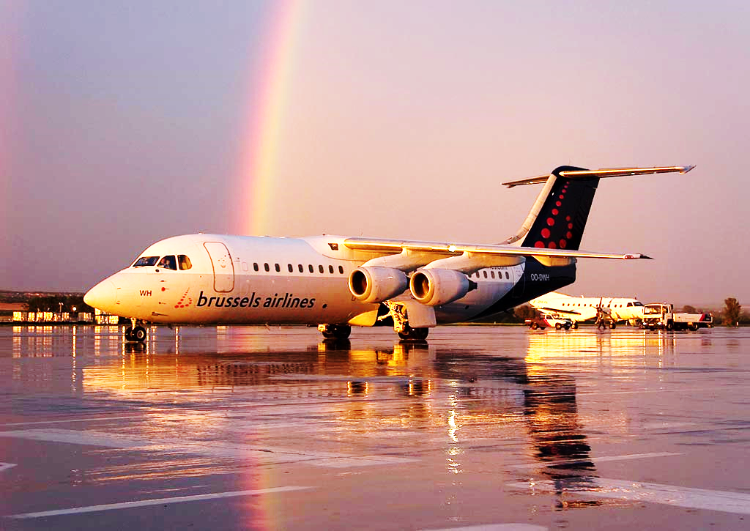
ANALYSIS OF AIRLINE DATASETS
SUBMITTED BY:
NAME: RISHABH JAIN
SHARMA CHETAN
TUSHAR SHARMA
SARTHAK BHARADWA
SUBMITTED TO:
NAME: NEHA SHROTRIYA

Slide 2
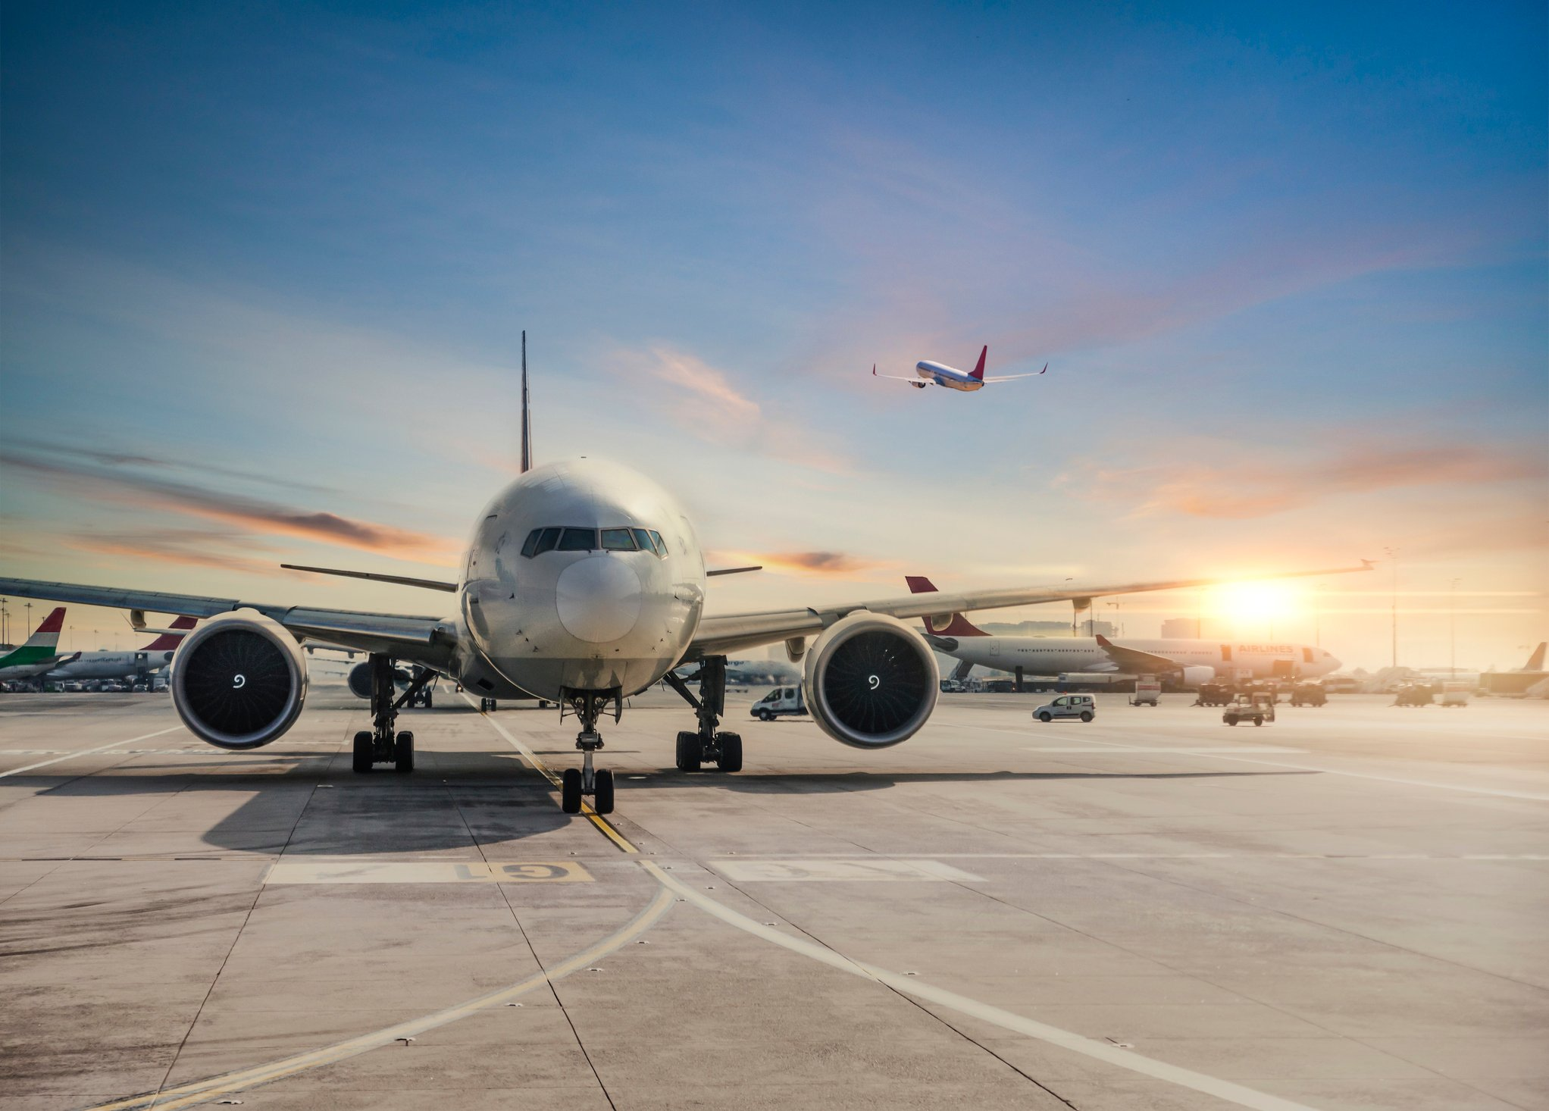
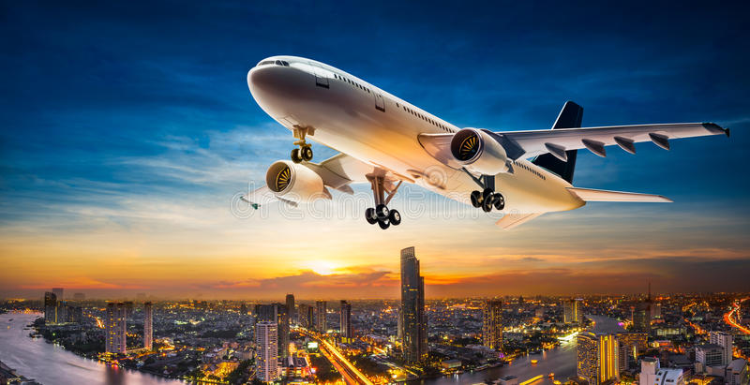
AGENDA • Timeline - Airline Industry • Need Set • Growth in India • Market Size • Cost Structure • Recent Events • Regulations • Critical Success Factors • Dynamics of Industry • Analysis of Players – Jet Airways – SpiceJet – Kingfisher Airlines • Investment Requirement • Future Outlook

Slide 3
TIMELINE – AIRLINE INDUSTRY
YEAR | MILESTONE
<1953 | Nine Airlines existed including Indian Airlines & Air India
1953 | Nationalization of all private airlines through Air Corporations Act
1986 | Private players permitted to operate as air taxi operators
1994 | Air Corporation act repealed; Private players can operate schedule services
1995 | Jet, Sahara, Modiluft, Damania, East West granted scheduled carrier status
1997 | 4 out of 6 operators shut down; Jet & Sahara continue
2001 | Aviation Turbine Fuel (ATF) prices decontrolled
2003 | Air Deccan starts operations as India’s first LCC
2005 | Kingfisher, SpiceJet, Indigo, Go Air, Paramount start operations
2007 | Industry consolidates; Jet acquired Sahara; Kingfisher acquired Air Deccan

Slide 4
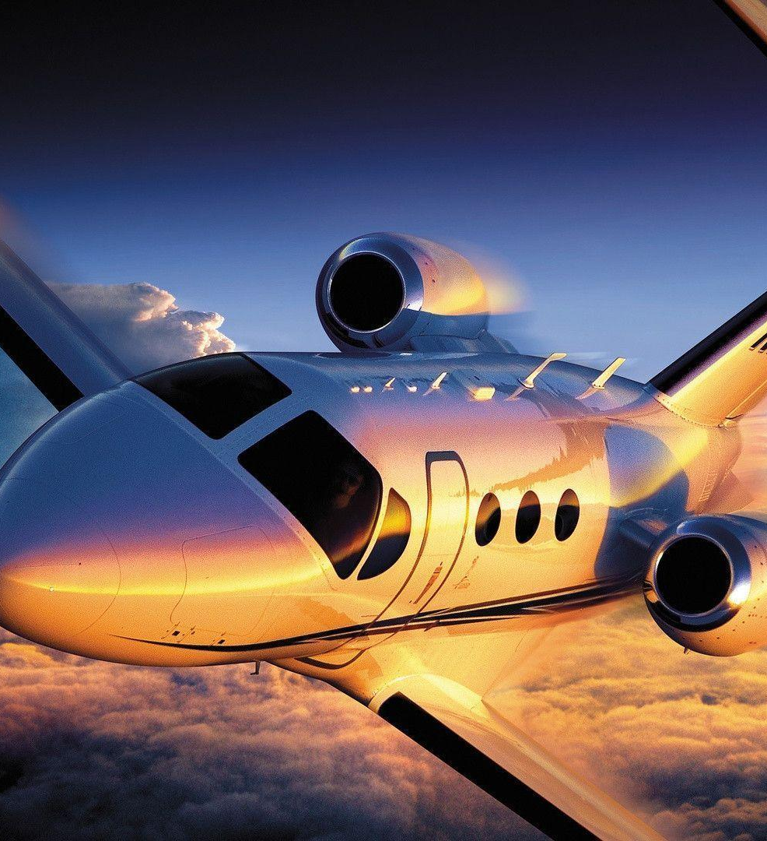
Need Set
Need to travel in an airline:
Primary Need: To meet another person (Communication)
Secondary Need: Transportation
Tertiary Need: Faster means to travel
COMPETITION:
• Railways
• Bus
• Cars Generic

Slide 5
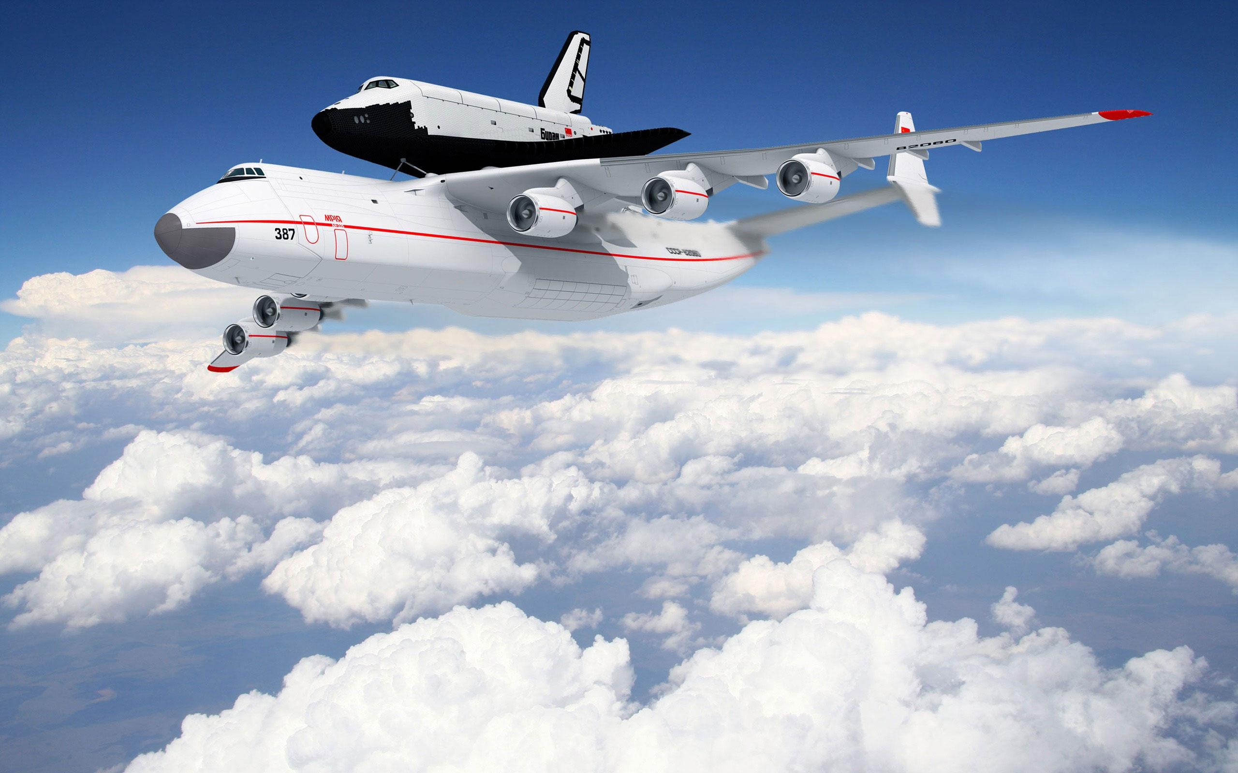
Growth in India
• Railway fares of AC tier and First class are
similar to airline fares
– Over 300 million strong middle class present in
India Domestic
• FDI in Aviation Growth
– Reduces the debt burden 25.6%
– Reduces operational costs due to availability of experts in the field of aviation
• Tourism in India
– Increase in inbound and outbound tourists and medical tourism
• Disposable incomes expected to increase an average of 8.5% till 2015
• Airports Authority of India (AAI) announces new airports in Tier II and Tier III cities
– Increases the demand for airline travel
– Operational costs are very low and growth rates are high when compared to metro and Tier I cities
• Higher profits

Slide 6
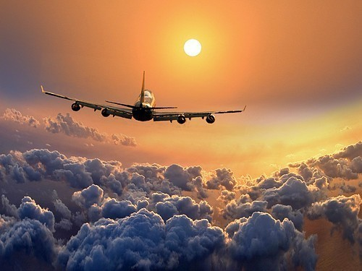
Market Size
During january-august 2018, domestic air passenger traffic rose 23.14 per cent to 64.47 million from 52.36 million during the same period in 2017
Passenger traffic during FY 2015-16 increased at a rate of 21.3 per cent to 85.57 million from 70.54 million in the FY 2014-15.In july 2016, total aircraft movements at all indian airports stood at 168,400, which was 14.3 per cent higher than july 2015
International aircraft movements increased by 8.2 per cent to 32,830 in july 2016 from 30,330 in july 2015
Domestic aircraft movements increased by 15.8 per cent to 135,570 in july 2016 from 117,050 in july 2015.
India is among the five fastest-growing aviation markets globally with 275 million new passengers

Slide 7
Pricing and cost factors
Price of Oil :
This is the big one, because nothing adds to an airline's cost of doing business like the price of jet fuel. In 2011, it became the No. 1 operating expense, zooming from about 20 to 40 percent, and that was after oil prices eased from 2008's high of nearly $150 per barrel. The price is currently hovering around $93, but it passed the $100 mark just after Christmas.
Flight Distance :
The farther you fly the more expensive your ticket will be. But not always! A flight between Los Angeles and Portland, Oregon., booked last week for late January, cost about $160 round-trip. But if you flew twice as far -- to Chicago, say -- you didn't pay double. That airfare was only another $14 each way. Remember, several factors contribute to ticket prices, distance being just one of them.
Competition :
The more airlines, the merrier -- for passengers. Fierce competition means lower ticket prices. Recent examples of more airlines causing lower prices: flights to and from Delhi and Mumbai.

Slide 8
Timing of Purchase:
When you buy your tickets matters. If you buy at the last minute – typically within seven days of departure, as business travelers do –you’ll pay a hefty premium (which is why airlines love their road warriors). The best time to buy domestic tickets is between three-and-a-half months and two or three weeks before departure. The best day to buy is Tuesday, starting at about 3 p.m. E.T. (which is when all airfare sales have been released and competing airlines have matched the new, lower prices).
Passenger Appetite:
If airlines price their tickets too high, people won't fly. It works, too; last year, individual airlines tried to raise ticket prices on 12 separate occasions, but competing carriers said "no" and the hikes didn't happen. Those naysaying airlines knew the higher prices wouldn't fly with their customers, and if people don't fly, airlines don't make money. Note: Three of those 12 hikes were considered “successful,” but they were very narrow in scope.
Fees:
Although fees aren't strictly part of an airline ticket, they might as well be on some airlines -- unless you’re the rare nudist traveler who never gets thirsty. Case in point is Spicejet Airlines, which charges for checked bags -- as most airlines do now -- but also for carry-ons.

Slide 9
Impact on Indian economy
The growth in the Indian economy has increased the Gross Domestic Product above 8% and this high growth rate will be sustained for a good number of years.
Air traffic has grown enormously and expected to have a growth which would be above 25% in the travel segment. In the present scenario around 12 domestic airlines and above 60 international airlines are operating in India.
With the growth in the economy and stability of the country India has become one of the preferred locations for the trade and commerce activities.
The growth of airlines traffic in Aviation Industry in India is almost four times above international average.
Aviation Industry in India have placed the biggest order for aircrafts globally.
Aviation Industry in India holds around 69% of the total share of the airlines traffic in the region of South Asia.
The Indian aviation industry contributes around INR 330 billion to the country’s gross domestic product.
The contribution the industry has made to the country’s economy in the last couple of years can best be described as phenomenal.
Globally, it is one of the fastest growing industries.
The entry of private operators in the industry and cut in air travel and prices, the industry became popularized in the country

Slide 10
Some major initiatives undertaken by the government are:
The Ministry of Civil Aviation has finalized and put forward for approval to the Union Cabinet, the new aviation policy, which includes proposals such as allowing new airlines to fly abroad, introduction of more regional flights and a new formula for granting bilateral flying rights.
The Indian Space Research Organization (ISRO) has signed a memorandum of understanding (MoU) with the Airports Authority of India (AAI), aimed at providing space technology for construction of airports

Slide 11
Conclusion
India’s aviation industry is largely untapped with huge growth opportunities, considering that air transport is still expensive for majority of the country’s population, of which nearly 40 per cent is the upwardly mobile middle class.
The industry stakeholders should engage and collaborate with policy makers to implement efficient and rational decisions that would boost India’s civil aviation industry. With the right policies and relentless focus on quality, cost and passenger interest, India would be well placed to achieve its vision of becoming the third-largest aviation market by 2020 and the largest by 2030.
The increase in the tourism sector of India which is booming the aviation sector plays a major role in impacting the economy of India and making the GDP growth rate rising subsequently.

Slide 12


